Slide 1
Inside and outside the climate negotiations: Contrasting networks of conference diplomacy reporting and media perception
Paula Castro (University of Zurich),
Marlene Kammerer (University of Bern)
WTI Brown Bag Seminar, 22 October 2019, Bern
Notes:
Hello everybody, thank you for giving me the opportunity to present my research here at WTI. This presentation is joint work with Marlene Kammerer, from the University of Bern, who unfortunately couldn’t join today as she herself is hosting a workshop here in Bern today and tomorrow.
So this is a very new and exciting project about comparing, contrasting and assessing interlinkages between international cooperation on climate change within the official negotiations under the United Nations Framework Convention on Climate Change, with broader climate-related cooperation (outside this forum) as portrayed by the media.

Slide 2
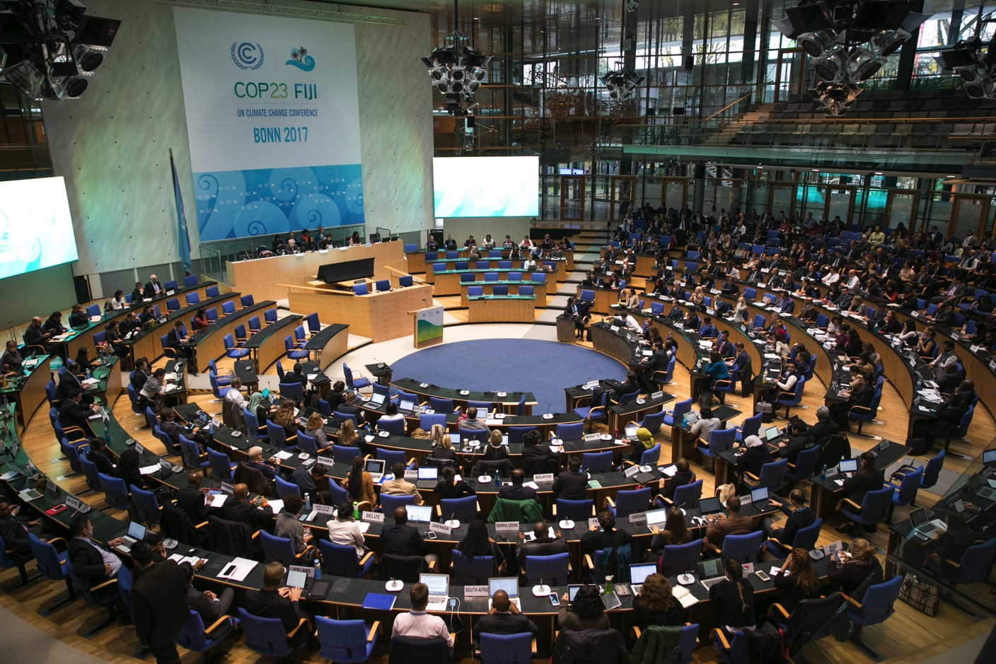
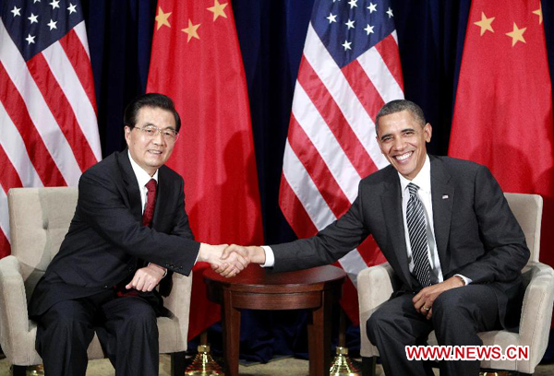
Cooperation inside and outside the negotiations
Notes:
While the multilateral negotiations under the UNFCCC have traditionally been the main forum to discuss and agree how to address climate change, the discussions have progressed very slowly and the response has so far been ineffective.
As a response, in recent years climate change has begun to be addressed across multiple channels (and by multiple governmental, non-governmental, intergovernmental and transnational actors) outside the official negotiations. Climate change, for example, has been a recurring topic in G8 and G20 meetings; a bilateral agreement between the US President Obama and the Chinese President Xi Jinping arguably paved the way for the success of the 2015 Paris Agreement. While the UNFCCC remains central, climate change governance has become more and more polycentric, and other channels of cooperation and influence are increasingly being used.
→ So far there is little systematic research into the potential interrelationships between both spheres of governance.
So, our original idea for this paper was to really look into how outside cooperation and the “official” UNFCCC negotiations interact with each other. To propose some hypotheses on the basis of multilevel governance and polycentric governance theory and test them. For this purpose, we rely on two very rich datasets of cooperation on climate change inside and outside the negotiations:
One of the datasets codes cooperative and conflictive interactions between country dyads at the UN climate change negotiations, based on summaries of these negotiations. This is our “inside” dataset.
The other one codes cooperative and conflictive interactions between country dyads, coded from international press releases. This is the “outside” dataset.
So these two datasets arguably present complementary views of climate change diplomacy – one is the more detailed insider view of the negotiation process, and the other one, while also presenting the most salient outcomes of these negotiations (which we can of course exclude for the analysis), also describes important cooperation events outside the negotiation process, including joint diplomatic declarations, international aid, new transnational initiatives, etc.
But while working on the paper and with the data, we increasingly noticed that in addition to our expectations regarding actual inside and outside cooperation on climate change, there is a filter no our data imposed by the way the press reports on climate change.
So, today, while I am trying to tell you a story about complex, polycentric governance, I am also telling you a story about media perception and media bias. So, we kind of believe we have to decide for one of both stories here, but are still unsure about which…

Slide 3
Research goal
Gain a more systematic understanding of the interlinkages between the way countries (are reported to) interact in the UNFCCC negotiations and the way (the press reports that) they cooperate outside the negotiation rooms

Slide 4
Expectations (I)
Differences: two sides of one coin
Hypothesis 1: small / vulnerable countries
“Outside” press reporting on climate change diplomacy is driven by a strong focus on key actors, whereas “inside” the negotiations smaller and more vulnerable countries are highly active.
Hypothesis 2: coalitions
While “inside” the climate negotiations diplomatic interactions are driven by coalitions of like-minded countries, such groups are less important for the diplomatic interactions reported by the “outside” media.

Slide 5
Expectations (II)
Interlinkages: polycentricity, complementary process
Hypothesis 3: outside diplomacy
Outside cooperation may help to pave the way for more cooperative negotiations under the UNFCCC.

Slide 6
Two datasets, two perspectives on cooperation
The ENB (inside) dataset
“BRAZIL, supported by CHINA, highlighted that the CDM cannot continue unless the Kyoto Protocol continues” (ENB No. 491, 3.12.2010)
62097 negotiation interactions
between 222 countries and coalitions
over 461 negotiation days
between 1995-2013
Conflictive interactions:
-3: Criticize
-2: Oppose
-1: Delay proposal
Cooperative interactions:
1: Agree
2: Support
3: Speak on behalf of
Notes:
The inside dataset codifies summaries of the UNFCCC climate change negotiations published in the Earth Negotiations Bulletins between 1995 and 2013.
Each observation in the dataset is a negotiation event, with a dyad of interacting countries, the type of interaction (cooperative or conflictive), its topic and the date in which it took place.
Our quantitative analysis in this paper so far focuses on the last 2 types of interactions. Strong cooperation, directed ties!
51625 events if we do not include the coalitions (but we do include the EU)

Slide 7
Two datasets, two perspectives on cooperation
The POLCLIMATE (outside) dataset
“A senior US official blamed divisions within the European Union for blocking a deal at the UN climate talks here Saturday and held out the hope of reviving the negotiations, AFP”
US accuse EU, Conflict (criticize, accuse, disapprove)
Press releases (AFP) on bilateral negotiations, aid, sanctions, information exchange, political support, meetings, etc.
Automated coding (TABARI)
Conflict & cooperation according to adjusted CAMEO coding scheme
1843 events, between 62 countries, period 1995 -2015
Notes:
Automatic coding of AFP press releases
Software identifies country / actor names and verbs
Each verb is assigned to a specific cooperation category
Political climate-related interactions that are collateral to the COPs:
Bilateral negotiations, aid, sanctions, exchange of information, political support, meetings, etc.
As reported in the press
Bias due to press attention
Focus on key global players
1843 events, between 55 countries, in period 1995 – 2015. Highly reciprocated, so assumed to be undirected.

Slide 8
Data analysis
Descriptive and dynamic social network analysis
Both processes are endogenous
Cooperative interactions take place repetitively over time, are not independent from each other
Network-based approaches are appropriate to model these interdependencies
Descriptive analysis: Annual data from 1995 to 2013 (15) to compare
Number of countries involved
Number of conflictive and cooperative interactions
(Several network statistics)
Notes:
Observations (ties): existence of cooperation between each pair of actors within a year.
Inside: at least 1 strongly cooperative interaction between a pair of countries during a specific year.
Outside: at least 1 cooperative interaction (of any cooperation level)
Why did we aggregate – want to compare general metrics/ descriptive stats. But most importantly, we wanted to asses network coevolution. We used Stochastic Actor-Oriented Models (SAOMs) using R-Siena (as we will see later, a model that needs time steps, instead of a sequence of events). Hence, we collapsed data to match this structure.
But we are thinking about other potential methods to model our data, such as Dynamic Network Actor Models (DyNAMs such as in the Goldfish).

Slide 9
Data analysis
Dynamic multiplex network model: Focus on three years (2007 to 2009)
2007 Bali Road Map (t0)
2008 Negotiations on Kyoto Follow Up (t1)
2009 Copenhagen Failure (t2)
Modelled using Stochastic Actor-Oriented Models in R-Siena
Observations (ties): existence of cooperation between each pair of actors within a year
Inside: at least 1 strongly cooperative interaction between dyad during year t
Outside: at least 1 cooperative interaction (of any cooperation level) between dyad during year t
Notes:
Why did we aggregate – want to compare general metrics/ descriptive stats. But most importantly, we wanted to asses network coevolution. We used Stochastic Actor-Oriented Models (SAOMs) using R-Siena (as we will see later, a model that needs time steps, instead of a sequence of events). Hence, we collapsed data to match this structure.
But we are thinking about other potential methods to model our data, such as Dynamic Network Actor Models (DyNAMs such as in the Goldfish).

Slide 10
Descriptive results

Slide 11
Number of countries
Notes:
Clearly, the media reports about far fewer countries than actually have participated in the climate negotiations.
Given that the outside dataset is based on international press releases, it is natural that the coverage of events taking place in smaller countries is comparatively limited, but the focus is mainly on key global players or on large events in which several countries participate.
In the outside interactions there is an increasing trend over time, as the climate topic gains in prominence. The number of actors decreases again in the aftermath of the failure of the negotiations in Copenhagen in 2009, what is probably linked to declining media attention.
The UNFCCC was from the beginning a universal forum meant to include all countries contributing to and affected by climate change – therefore the much larger number of countries involved.
Inside, peaks with respect to important events, and troughs when the negotiations become less political and more technical.

Slide 12
Number of countries: only (strong) cooperation
Notes:
Figure 2 displays again the number of active actors, but focusing only on the cooperative interactions for the outside dataset, and the strongly cooperative interactions for the inside dataset. Clearly, the number of actors involved in both diplomatic arenas is now more comparable.
The dynamic network analysis focuses on this subset of interactions.

Slide 13
Number of (strongly) cooperative interactions
Notes:
Figure 3 compares the number of strongly cooperative inside interactions with the number of cooperative outside interactions over time. Again, we tend to have more diplomatic interactions at the negotiations than in the outside world as portrayed by the press, which is not surprising given the different nature of interactions coded in each of the datasets. In addition, we again see peaks of activity reflecting some of the busiest years of climate actions.

Slide 14
Network density (cooperative interactions)
Notes:
Density: Network cohesion – share of interactions present relative to all theoretically possible interactions, over time.
Density = existing ties / all possible ties

Slide 15
Network average degree (cooperative interactions)
Notes:
Average degree = average number of ties of each node
Network cohesion – average number of interactions per country, over time.

Slide 16
Top 10 actors, 2007-2009, »inside»
Notes:
Degree centralization:
Number of central countries, over time
Is the network dominated by one, or a few, very active (central) actors?

Slide 17
Top 10 actors, 2007-2009, »outside»
Notes:
Degree centralization:
Number of central countries, over time
Is the network dominated by one, or a few, very active (central) actors?

Slide 18
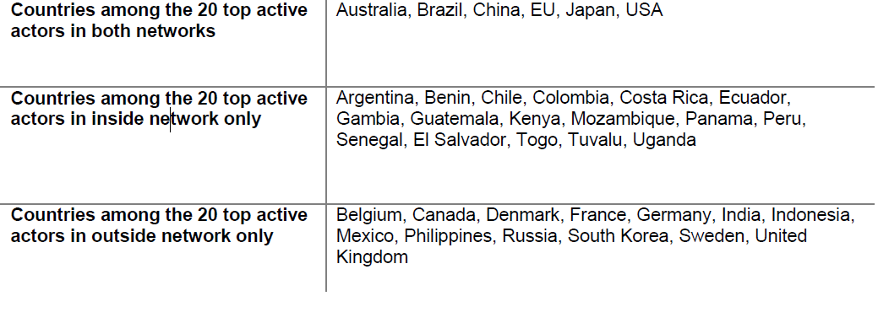
Top active actors in both networks

Slide 19
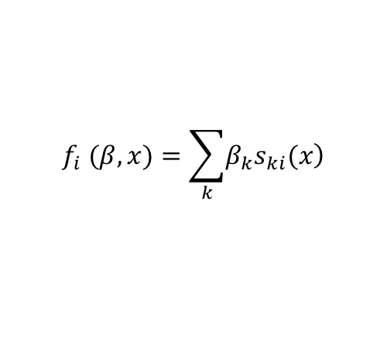
Stochastic actor-oriented model
The objective function
Model specification
Within-network effects: density, degree, reciprocity, transitivity
Node-level covariates: GDP, CO2 pc
Dyadic covariates: same annex & common coalitions (H2)
Interaction term: vulnerability * degree (H1)
Co-evolution: Outside on inside (H3)
$$f_{i} (β,x)=\sum_{k}{\left.β_{k}s_{ki}(x\right)}$$
Notes:
SAOMs designed to assess tie formation dynamics in panel network data.
Each network is measured at discrete time points, in our case the years 2007 to 2009.
The objective function models the probability of tie change in the network on the basis of a linear combination of a set of effects.
(We use a co-evolution model that allows us to study potential interactions between our two networks (multiplex dynamics).
In our case, we include
three basic within-network effects: outdegree, reciprocity (only for the inside network) and transitivity (gwesp).
Two node-level covariates expressed as homophily: total GDP and CO2 emissions per capita (the more similar the countries, the more we would expect them to cooperate)
Two dyadic covariates: same annex and number of common coalitions
One interaction term: vulnerability * degree (interested in whether more vulnerable countries are more active)
One multiplex term: outside on inside (so far contemporaneous, in future we will also explore lags)
H1: Outside” press reporting on climate change diplomacy is driven by a strong focus on key actors, whereas “inside” the negotiations smaller and more vulnerable countries are highly active.
H2: While “inside” the climate negotiations diplomatic interactions are driven by coalitions of like-minded countries, such groups are less important for the diplomatic interactions reported by the “outside” media.
H3: (Past) Outside cooperation may help to pave the way for more cooperative negotiations under the UNFCCC.

Slide 20
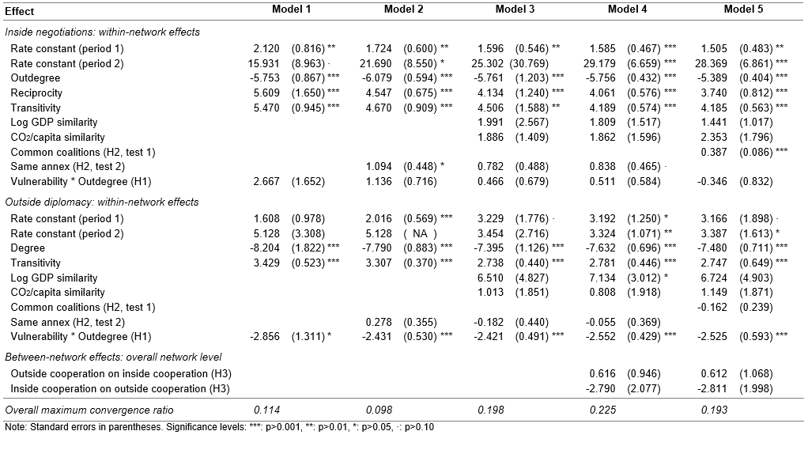
Results
H1 (key vs. vulnerable ✔️ actors)
H2 (coalitions) ✔️
H3 (interdependency) ❌
Notes:
Here we have the first results of the multilevel stochastic actor-oriented models.
Models 1 to 3 include basic within-network effects and covariates that allow us to test Hypotheses 1 and 2, and models 4 and 5 add the multilevel between-network effects necessary to test Hypothesis 3.
Very good convergence, with an overall convergence ratio below the threshold of 0.25 recommended by the RSiena manual.
All significant effects are robust across the five different specifications.
All network dependencies behave as expected. Across all models, the degree parameters are highly significant and have the negative sign we expect for this type of sparse networks. The reciprocity parameter included in the inside network is highly significant and has a large positive coefficient, which supports the idea that countries tend to reciprocate cooperative behavior by their peers. In both networks, the transitivity parameter is positive and significant across all models, reflecting the tendency of actors to cooperate with the friends of their friends.
According to our Hypothesis 1, we expect that outside reporting on climate change diplomacy focuses on large key actors, whereas inside the negotiations smaller and more vulnerable countries are more active.
Operationalization: Interaction between vulnerability and outdegree: negative and significant coefficient across all models for the outside network, but never significant for the inside network.
While we do not find support for the idea that vulnerable countries tend to be particularly active in the inside network, we find support for the idea that they tend to be less active in the outside network. Together with the findings of the descriptive analysis above, this result lends some support to Hypothesis 1.
Under Hypothesis 2 we expect that coalitions or groups of like-minded countries drive cooperation in the inside negotiations but not necessarily in the outside diplomacy.
Operationalization: Covariates common coalitions and same annex.
The positive and strongly significant effect of common coalitions in the inside network in Model 5, as well as the positive and significant effect of same annex in the inside network in Models 2 and 4 support the first part of this hypothesis.
Interestingly, dyads that are more similar in terms of the size of their economies or of their CO2 emissions per capita do not tend to cooperate more inside the negotiations.
In the outside dataset, we find that neither common coalition membership nor being in the same annex lead to increased cooperation, which is in line with the second part of Hypothesis 2.
However, we have some (not very robust) evidence that countries that are similar in terms of the size of their economies (GDP) tend to cooperate more in the outside negotiations.
The idea that outside diplomacy might be interrelated with the inside negotiations was codified under Hypothesis 3. We particularly expected that more outside cooperation may lead to more cooperative inside negotiations. The multilevel dependencies that we used to test for such between-network effects in models 4 and 5 were never significant. It thus seems that the networks do not interact with each other, at least within the time period we chose for this detailed analysis (2007-2009).

Slide 21
Conclusions (so far)
Inside reports and outside media do present different views of climate diplomacy.
Interesting in itself to find out and compare differences and similarities.
H1: No stronger participation of vulnerable countries inside, but a weaker participation of them outside.
H2: Coalition logic inside, whereas homophily plays stronger role outside.
H3: So far no evidence of interdependency between inside negotiations and outside media perception.

Slide 22
Outlook
Framing
Right now not a story about complex governance
Instead: Inside and outside datasets are not (yet) cleanly “separated”
Results reflect press bias towards large actors
→ Rather a story about “outside perception about climate diplomacy” vs “inside view of negotiations”?
→ If we want to make a story about complex governance
Invest in further data collection
E.g. other press releases (more international, less biased)
Expand collection to cover non-state and sub-state actors
Notes:
Own ideas to address these issues:
Collect more data (e.g. further sources for outside diplomacy), and clean the data (omit all observations relating to the negotiations from outside dataset) to make this become a story of complex governance, really about 2 different policy arenas?
Or embrace the story about “outside (press) perception about climate diplomacy” versus “inside view of the negotiation process”?
→ What literature could we relate to in this second case?
Make the two data sets more comparable, for example collapsing EU outside; Small Island states

Slide 23
Outlook
Empirics
Different actors in 2 networks
→ Difficult to find out interlinkages
→ Could improve as well with new data collection for outside cooperation
Networks change a lot over time
→ Convergence issues with 3 waves
→ How to deal with 18 years of data?
Alternative modelling approaches to SAOMs
Dynamic Actor-Oriented Models (DyNAMs)

Slide 24
All ideas and suggestions are welcome!
Paula Castro Marlene Kammerer
castro@pw.uzh.ch marlene.kammerer@ipw.unibe.ch

Slide 25
Data: Cooperation outside the negotiations
Cooperation categories:
-6: Protest, boycott, reduce relations, stop aid, impose sanctions
-5: Threaten to reduce/stop aid, impose sanctions, or halt negotiations; give an ultimatum
-4: Reject material or diplomatic cooperation or aid
-3: Disapprove, criticize, accuse, complain
-2: Demand for material or diplomatic cooperation or aid
-1: Negative statement such a pessimistic comment
1: Positive statement, symbolic acts, express accord
2: Consult, make or host a visit, meet, negotiate, discuss
3: Appeal for material or diplomatic cooperation or aid
4: Express intent to engage in material / diplomatic coop
5: Ease sanctions, agree on political reform
6: Provide aid or engage in material / diplomatic cooperation
Notes:
Controls: either for sender and target, or for their difference
Differentiation: Income and GHG emissions
Negotiating power and skills: country size and language
Bilateral ties: democracy similarity, bilateral trade, bilateral aid flows, colonial past, same region, UN voting
Interests: agriculture, vulnerability, forestry, fossil fuel rents
Negotiation setting: same coalition, coalition and its member, UNFCCC / KP ratification status
Absolute and logged versions for population, emissions, GDP
We use a relational events model to test our hypotheses. This basically combines a logit model of the likelihood that an interaction is cooperative, with a survival (Cox) model about the frequency of (cooperative or conflictive) interactions over time.

Slide 26
Number of cooperative and conflictive interactions
Notes:
Figure 3 compares the number of strongly cooperative inside interactions with the number of cooperative outside interactions over time. Again, we tend to have more diplomatic interactions at the negotiations than in the outside world as portrayed by the press, which is not surprising given the different nature of interactions coded in each of the datasets. In addition, we again see peaks of activity reflecting some of the busiest years of climate actions.

